Slide 1


Driving Sales Excellence: Key Insights and Strategic Recommendations
This presentation provides a comprehensive analysis of our company's sales performance, identifying key insights and strategic recommendations to drive sustainable growth. By leveraging data-driven insights, we'll uncover opportunities and optimizations to enhance sales excellence across the organization.

Slide 2

Sales Performance Overview
2017
Sales grew by 8% year-over-year, with strong performance across key accounts.
2018-2019
Steady growth, with a 5% increase in sales each year. Identified top-performing and underperforming accounts
2020
Challenging year due to the pandemic, leading to a 3% decline in sales. Focused on retaining key accounts.
2021
Rebounded with a 12% year-over-year increase, indicating strong recovery and growth potential.

Slide 3
Product and Marketing Channel Performance
PRODUCT PERFORMANCE
MARKETING CHANNELS
INSIGHTS
Product 1 drove 45% of total sales, while Product 2 and 3 accounted for 30% and 25%, respectively. Identifying opportunities to optimize product mix and focus on high-performing items.
Social media campaigns were the most effective, generating 40% of sales. Coupons and catalog inclusion also performed well, contributing 25% and 20% of sales, respectively. Posters had the lowest impact at 15%.
By leveraging the most effective marketing channels and optimizing the product portfolio, we can unlock significant growth opportunities.

Slide 4
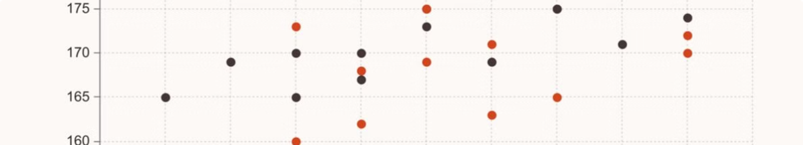
IDENTIFYING GROWTH OPPORTUNITIES
High-Growth Accounts
Focus Areas
Underperforming Accounts
Accounts sb7, sb9, and sb1 showed the highest year-over-year growth, ranging from 15% to 20%. Prioritize these accounts for deeper engagement and further expansion.
Accounts LMN and DEF underperformed, with a 5% and 8% decline, respectively. Investigate root causes and develop targeted strategies to improve their performance.
Concentrate sales efforts on expanding market share in high-growth industries, cross-selling complementary products, and improving customer retention through enhanced service and support.

Slide 5
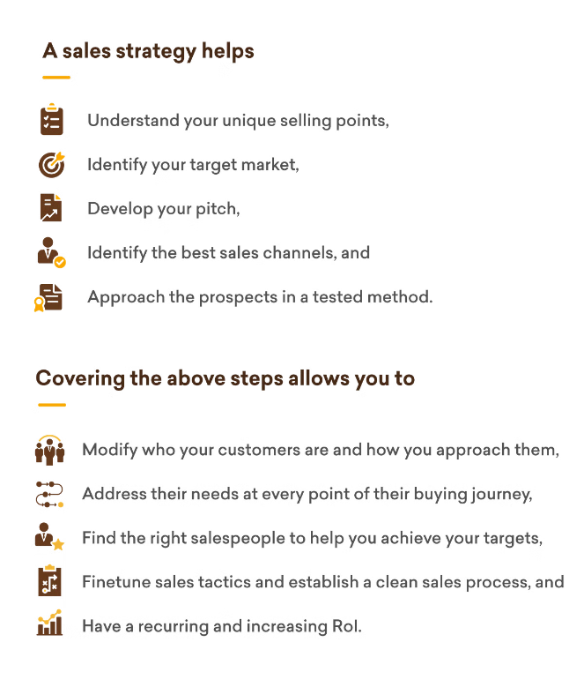
STRATEGIC RECOMMENDATIONS
Optimize Product Portfolio
Prioritize high-performing products, streamline the product mix, and explore opportunities for product innovation and line extensions.
Enhance Marketing Effectiveness
Allocate resources to the most impactful marketing channels, such as social media and targeted promotional campaigns, to drive increased visibility and engagement.
Deepen Customer Relationships
Invest in personalized account management, value-added services, and customer success initiatives to strengthen loyalty and unlock cross-sell and upsell opportunities.
Foster a Sales-Driven Culture
Empower sales teams with comprehensive training, tools, and incentives to enhance their skills, motivation, and overall effectiveness.

